Slide 1
Galactic Learning: Classifying Stars, Quasars, and Galaxies
Team Members: Ahmad Allaou, Daelyn Bergsman, Spencer Morris
October 26th, 2023, DataSci 207

Slide 2
Background
Sloan Digital Sky Survey (SDSS)
Pioneering astronomical survey
Operational 2000-present
Commissioned to study large-scale structure of the universe (galaxies)
Gone through many Science Phases w/ many science objectives
Discoveries related to black holes, exoplanets, and characterization of Milky Way
Astronomical Data
Many sensors
Photometric
Spectroscopic
Many shapes
0-D Scalars – point-wise redshift
1-D Vectors – detailed wide-band spectra
3-D tensors – 5-channel multispectral imagery

Slide 3
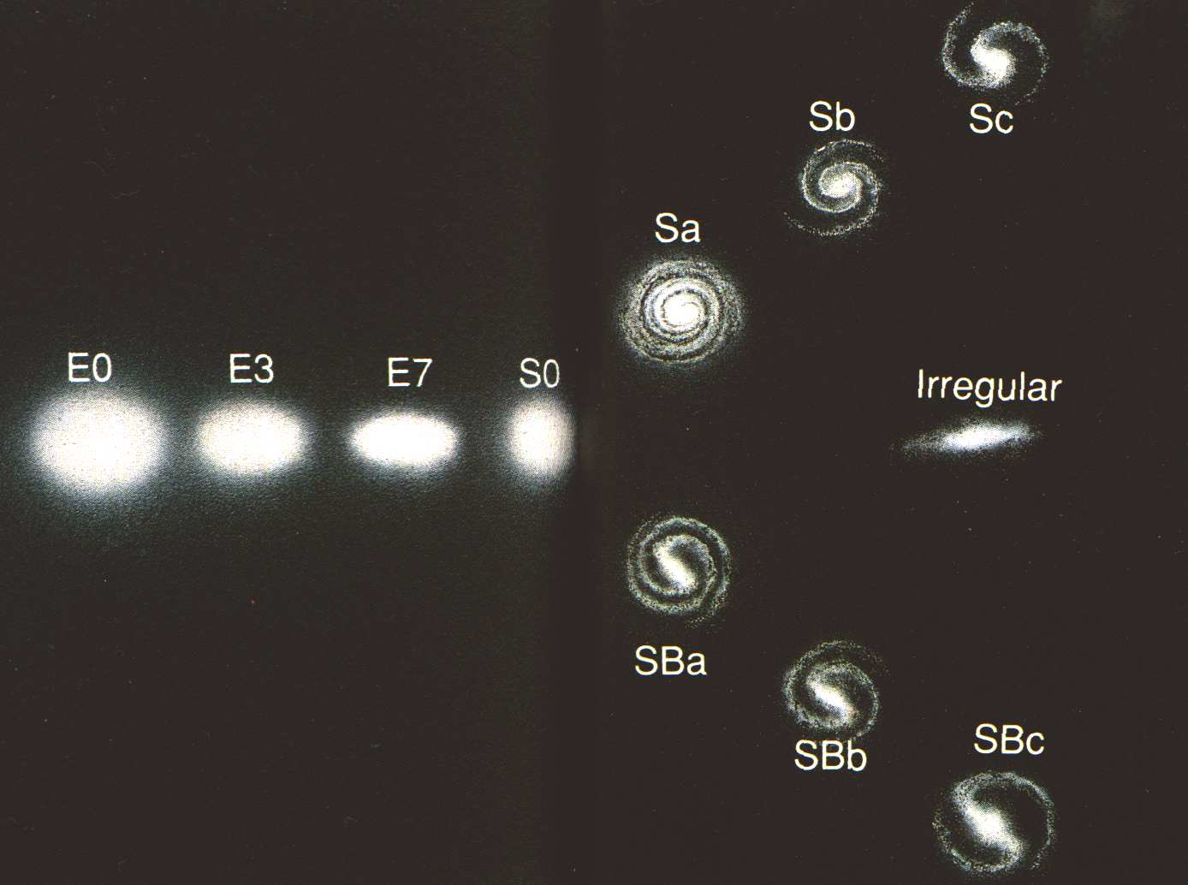
Galaxy Morphology
Hubble Fork for classifications
Elliptical
eccentricity
Lenticular
Spiral
Non-barred vs. Barred
# of spiral arms
Irregular

Slide 4
Problem Statement
We want to know what each celestial object is, how they are related, and the distribution of properties
There are an estimated 10^11 stars in each galaxy and 10^11 galaxies in the observable universe
SDSS alone has catalogued billions of objects
Galaxy Zoo Project
‘Citizen science’ initiative launched to crowdsource task of labeling galaxies by morphology
Launched the ‘Zooniverse’ data repository (for labeled scientific data)
A decision tree was used to facilitate volunteers generating labeled data
Galaxy Zoo 1 – broad morphological classifications
Galaxy Zoo 2 – specific morphological classifications

Slide 5
Objectives
Celestial object classification from SDSS scalar data
Star, galaxy, quasar, other
Galaxy morphology classification from SDSS images
Broad: Elliptical, lenticular, spiral, irregular, edge-on
Specific: Elliptical eccentricity, spiral # of arms, spiral bar, etc.
Notes:
Our objective in this project is to properly predict celestial objects based on the scalar data from SDSS, and galaxy type from images in the galaxy zoo 2 dataset.

Slide 6
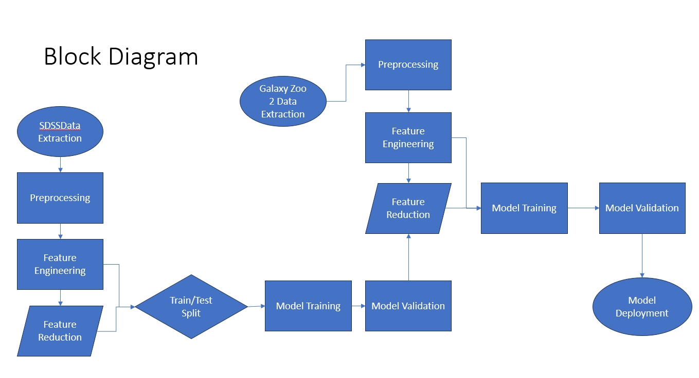
Block Diagram
Notes:
Here is our block diagram showing the flow of our data from both data-sets and how they interact with each other. The output of the first chosen model will be used for feature reduction for use in the second model to determine number of data points.

Slide 7
Datasets
Dataset 1: SDSS scalar data
Queried directly from SDSS Skyserver
Includes multiple queries from multiple tables
Each table is capped at 1 million rows
Consolidates Photometric, Spectroscopic, and Value-Added data for a variety of objects characterized and available in Data Release 8 (DR8)
Dataset 2: Galaxy images
Accessed from Galaxy Zoo data repository
Includes several hundred thousand 424^2-pixel images
Dataset 1: SDSS scalar data
Features
Redshift, ra, dec, u, g, r, i, z, & others
Labels
Celestial object class
Dataset 2: Galaxy images
Features
424x424x3 pixels (g, r, i)
Labels
Detailed morphological class
Notes:
As mentioned before our two datasets are the SDSS, and Galaxy Zoo 2. SDSS is scalar data and we paired down the number of features to focus on key indicators such as redshift and other spectroscopic values as seen on the right. For galaxy zoo 2 it is all image data with color, associated with a specific label from the project.

Slide 8
Approach & Evaluation Parameters
Data Pre-processing
Image compression, reduction, and augmentation
Hierarchical clustering for galaxy morphologies
K-Means clustering for celestial objects
Feature selection
Transformations and scaling as appropriate
Data Modeling
Random Forest
K-nearest neighbors
Feedforward neural networks
Convolutional neural networks
Model tuning and evaluation
K-fold cross validation
Grid search hyperparameter optimization for various models
Confusion matrix

Slide 9
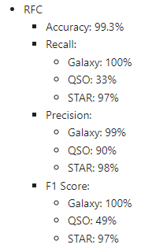
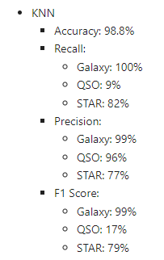
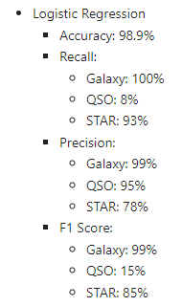
Preliminary Models
Began to look at preliminary models including random forest, KNN, and Logistic Regression (70-30 Train Test Split)
knn = KNeighborsClassifier(n_neighbors=5)
knn.fit(X_train, y_train)
y_pred_knn = knn.predict(X_test)
accuracy_knn = accuracy_score(y_test, y_pred_knn)
class_report_knn = classification_report(y_test, y_pred_knn)

Slide 10
Success & Failure
Success: Given that historical attempts at these image classifications yielded in accuracy scores of 80%, we consider a successful model to be at least 80%
Failure: A model with a suboptimal accuracy (<65%) or an inefficient model (one that takes too long to train) can be considered a failure even if the accuracy is close to the target

Slide 11
Questions?
Notes:
Ishaani Feedback: make sure to do PCA
Include some clustering
split the block diagram
check for overfitting

